Slide 1

Sprint 2
Tsanko Nedelchev

Slide 2

Sprint goals
Setup microservices design and layout
Create the Authentication microservice
Research microservices communication
Research API gateway

Slide 3

Sprint achievements
Researched and bootstrapped microservices
Created the Authentication microservice with:
User registration
Email verification
User authentication
Session handling with access and refresh tokens
Reset password
Logging
Created user authorization middleware for each microservice
Researched microservices communication

Slide 4
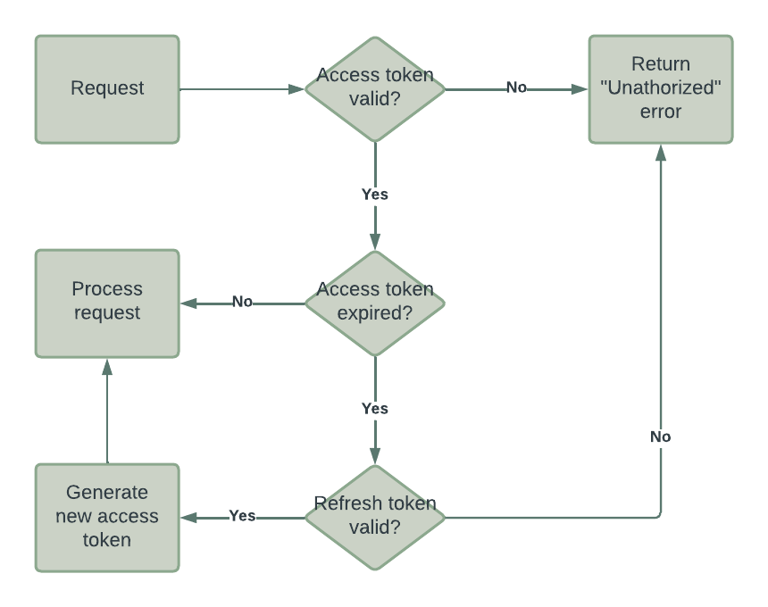
JWT Authentication Flow

Slide 5
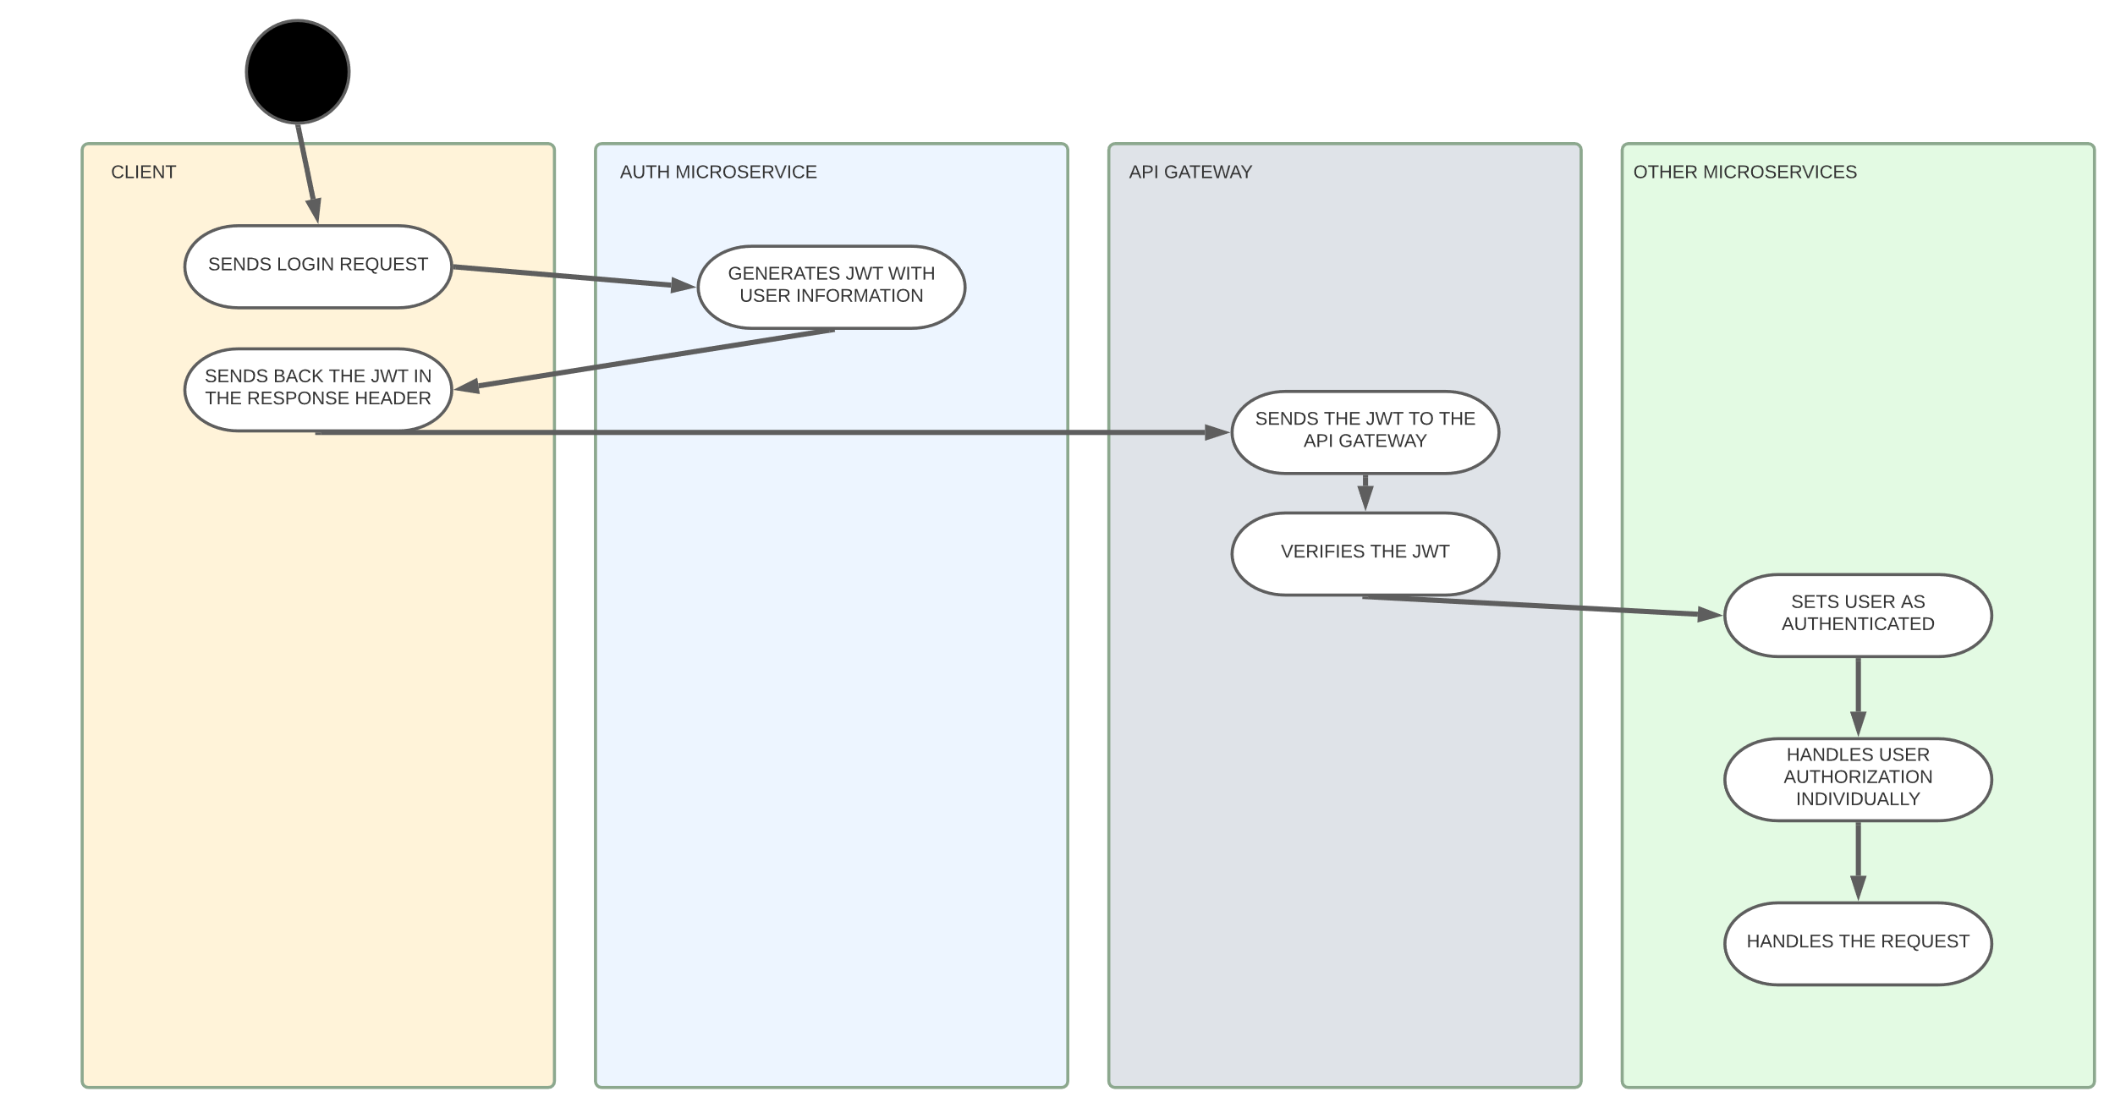
Application communication

Slide 6

Sprint Retrospective
Fairly good start of the development process
Already feel the time of the semester advancing
Need to increase productivity

Slide 7

Thank you!

